Slide 1
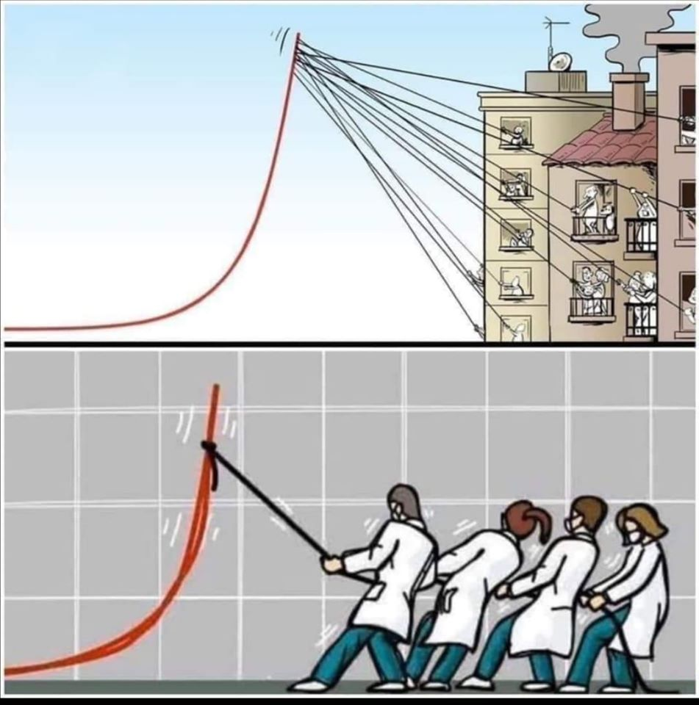
Zdroj: www.facebook.com/thesciproject/photos/a.229479417242442/1287192394804467/?type=3&theater

Slide 2
Zdroj: https://www.cartoonmovement.com/cartoon/65214

Slide 3
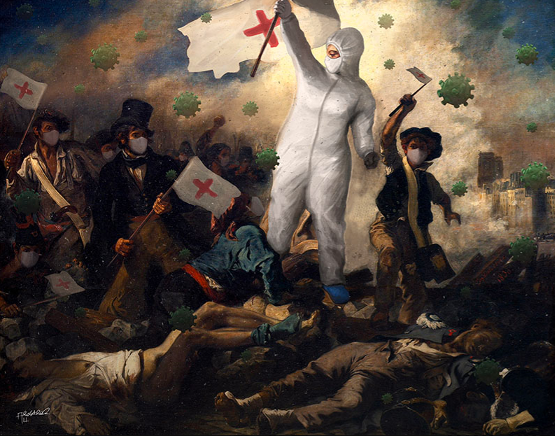
Zdroj: https://www.irancartoon.com/site/gallery/gallery-of-intl-cartoon-contest-we-defeat-coronavirus#&gid=1&pid=349

Slide 4
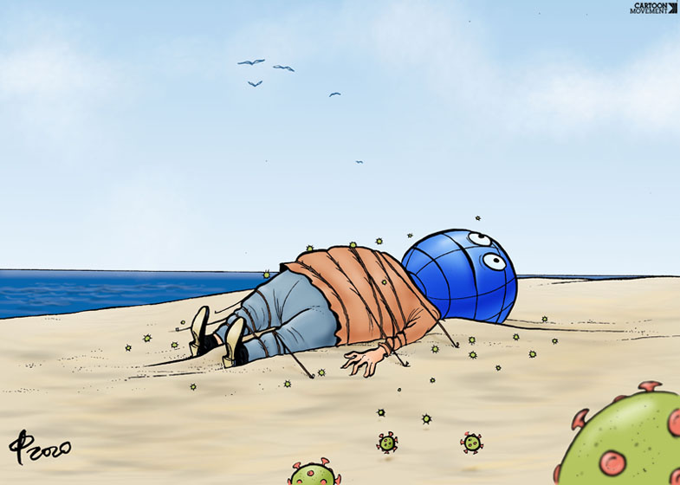
Zdroj: https://www.cartoonmovement.com

Slide 5
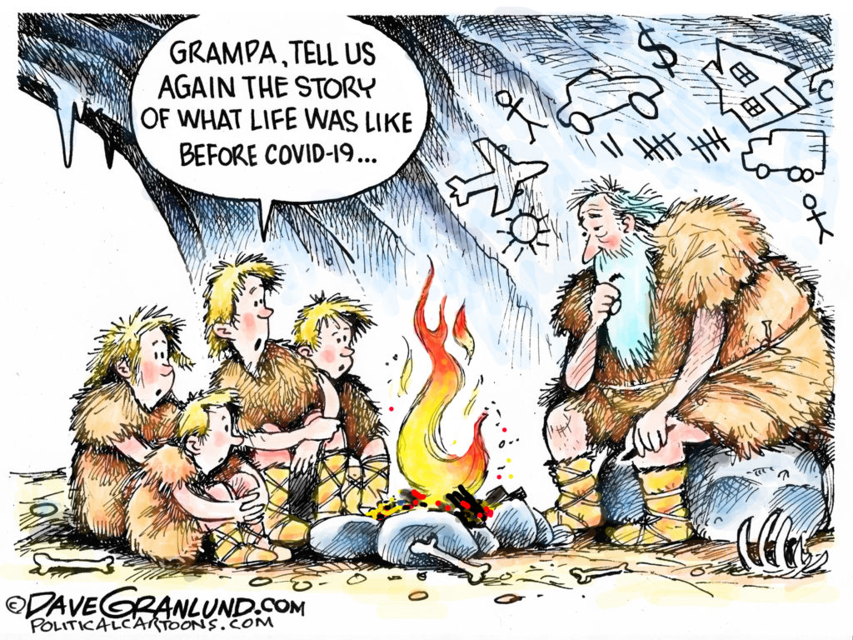
Zdroj: www.politico.eu/interactive/worlds-cartoonists-on-coronavirus-cartoons/

Slide 6
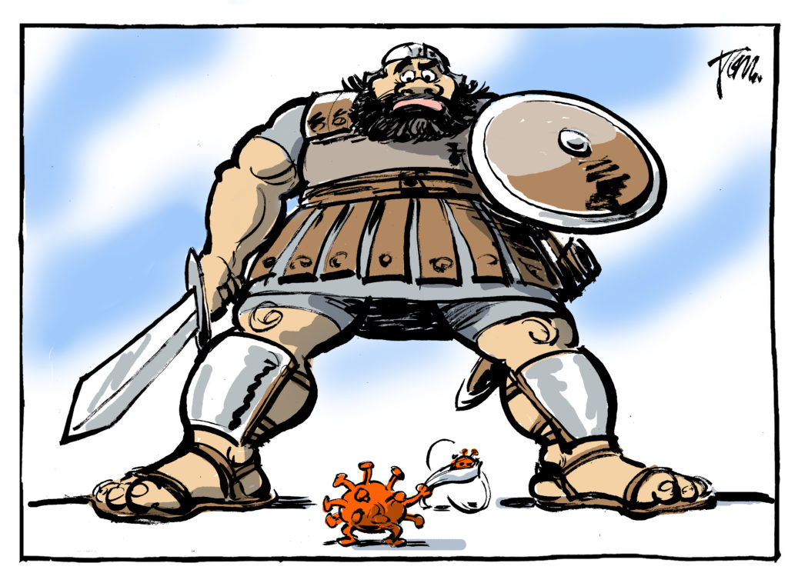
Zdroj: https://www.politico.eu/interactive/worlds-cartoonists-on-coronavirus-cartoons/

Slide 7
Zdroj: https://www.cartoonmovement.com

Slide 8
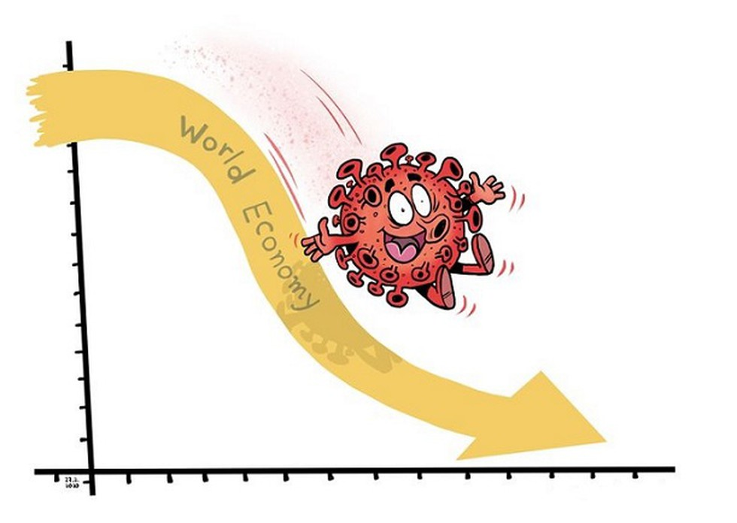
Zdroj: https://vajiramias.com/current-affairs/very-high-public-health-risk/5e5b1cde1d5def6623a2dde9/

Slide 9
Zdroj: www.irancartoon.com/site/media/zgalleries/48a7f0c22e984a86dcda31789e64208d/seyyed-yasin-hosseini-iran3.jpg

Slide 10
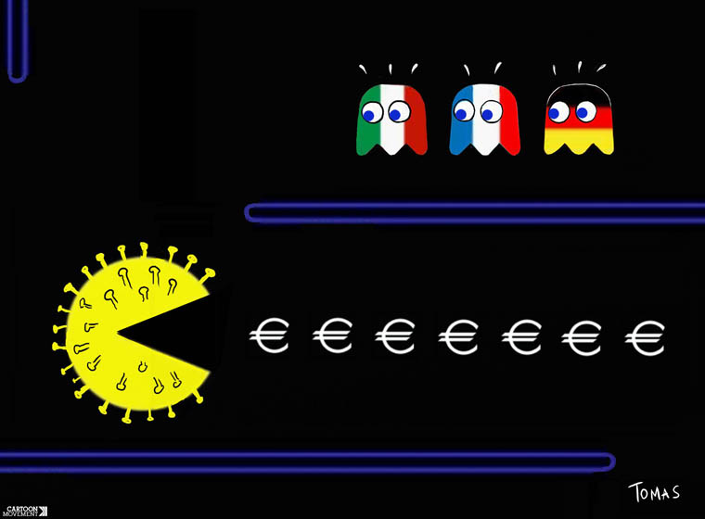
Zdroj: https://www.cartoonmovement.com/

Slide 11
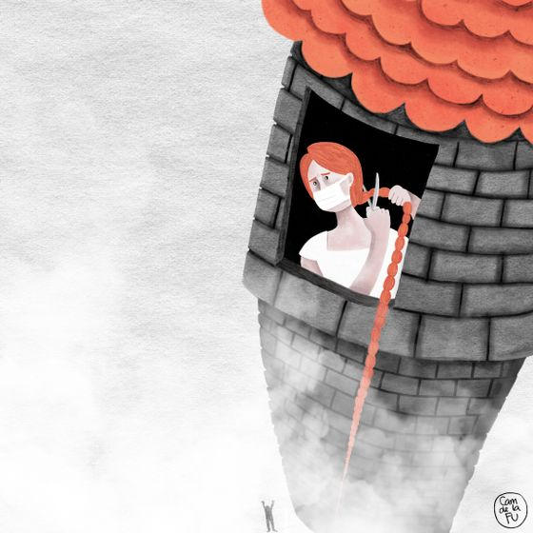
Zdroj: https://www.irancartoon.com/site/daily/cartoon#&gid=1&pid=1

Slide 12
Zdroj: https://thebridge.in/wp-content/uploads/2020/03/Olympics-1.jpg

Slide 13
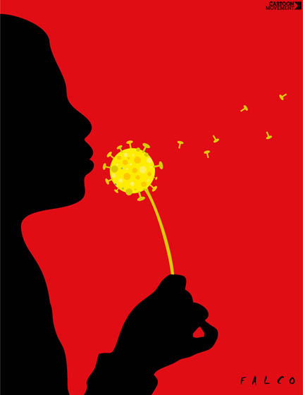
Zdroj: https://www.cartoonmovement.com/

Slide 14
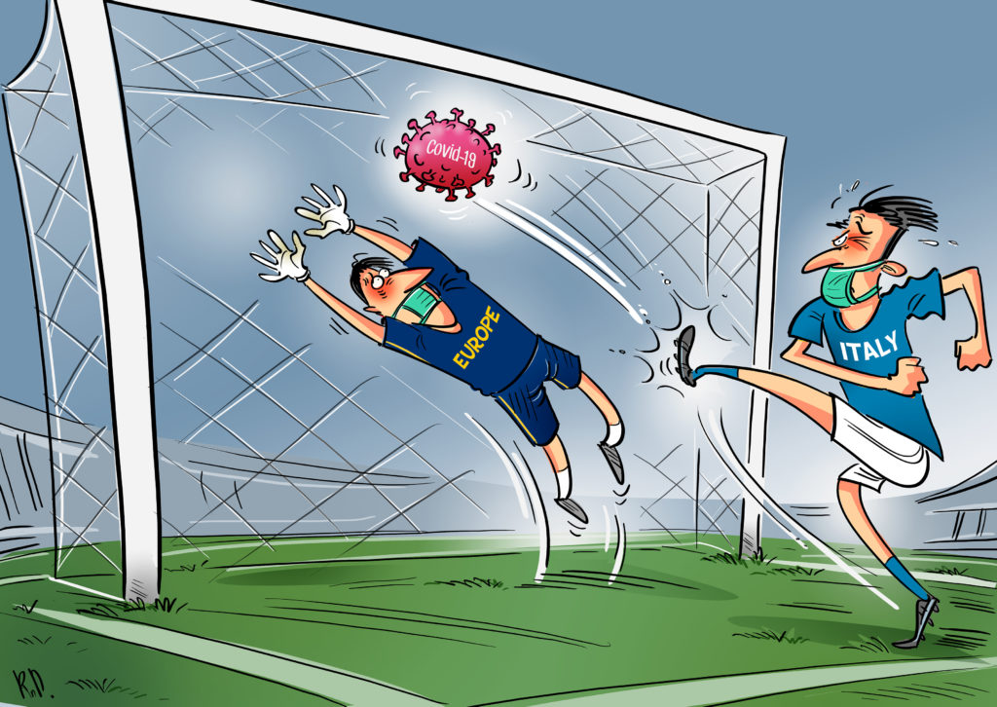
Zdroj: www.politico.eu/interactive/worlds-cartoonists-on-coronavirus-cartoons/

